Slide 1
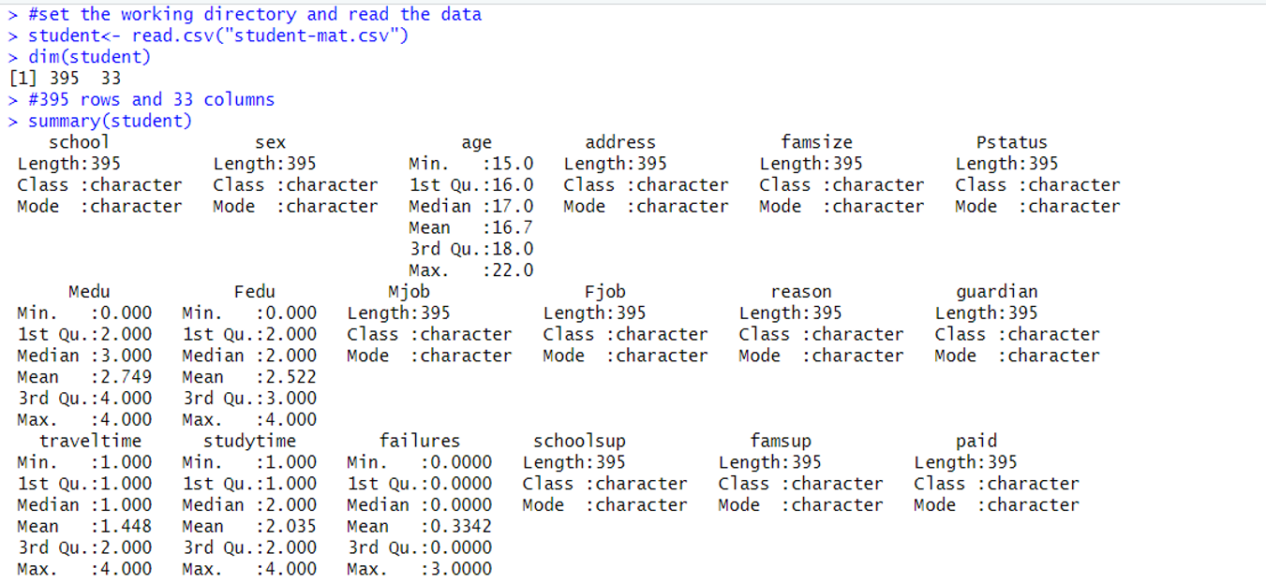
HYPOTHESIS TESTING IN R
Dataset: It consists of 395 rows and 33 columns related to school students

Slide 2
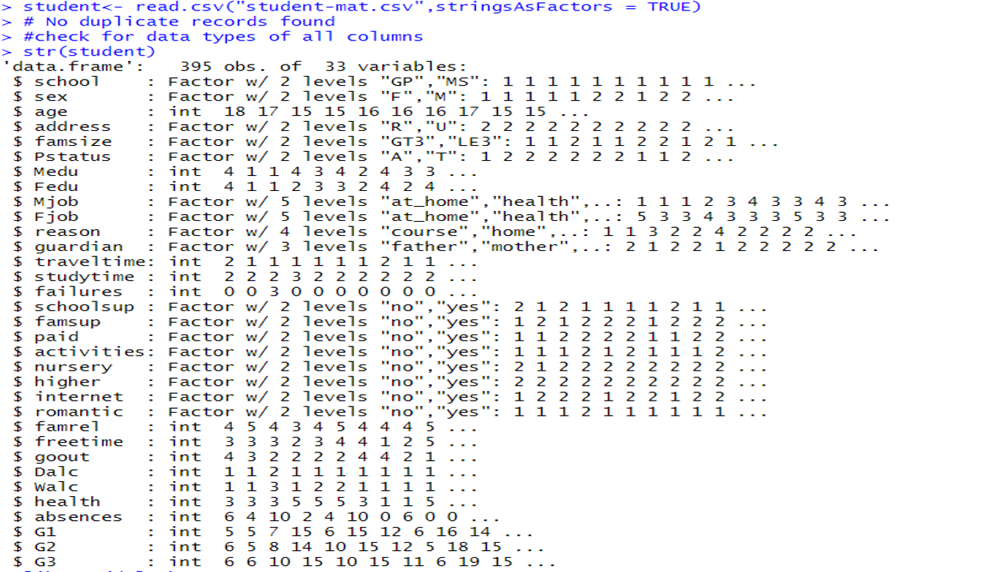
DATA CLEANING
Check for missing values and duplicated records but found none
Many columns having character vector were changed to factor vector

Slide 3
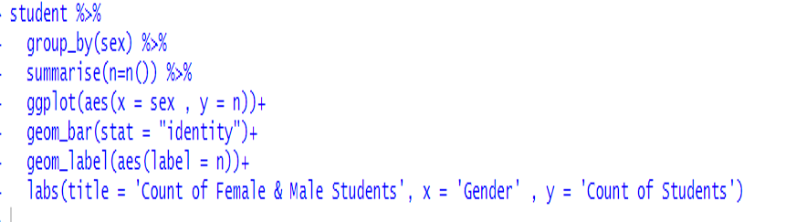
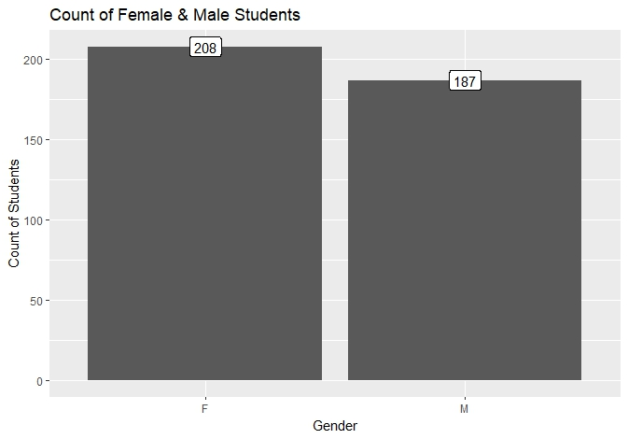
EXPLORATORY DATA ANALYSIS

Slide 4
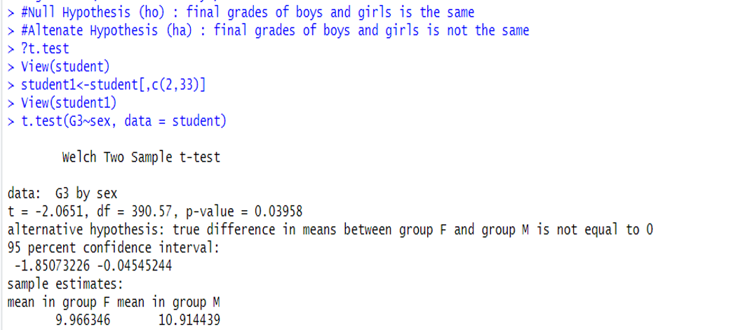
EXPLORATORY DATA ANALYSIS
We keep only two columns namely 'Sex' and 'G3' and remove the other columns. G3 refers to the final grades of the students
t=-2.0651 indicates a positive difference between our sample data and the null hypothesis
df = 390.57 indicates the number of levels in the independent variable minus 1
p value = 0.03958 is the probability value and indicates that we can reject the null hypothesis as it is less than that of alpha (0.05). Hence it is statistically significant.
We can see the difference in means between the two groups (10.91-9.96) = 0.95

Slide 5

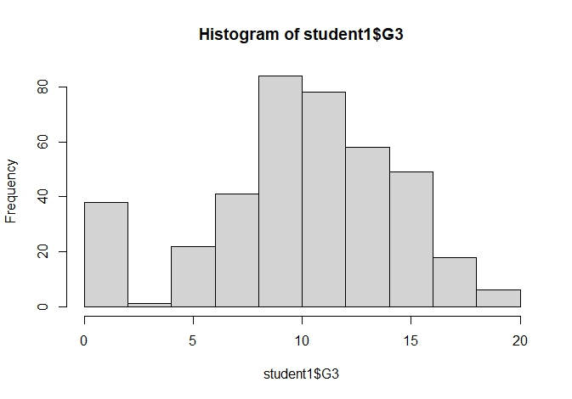
EXPLORATORY DATA ANALYSIS

Slide 6
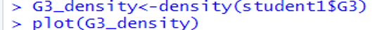
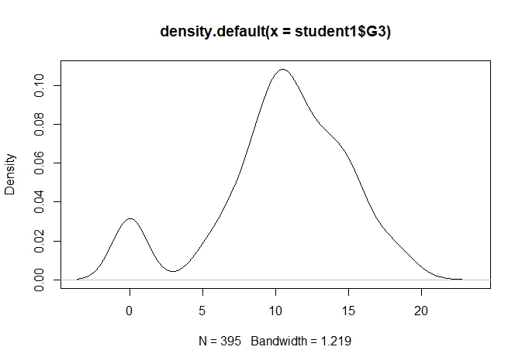
EXPLORATORY DATA ANALYSIS

Slide 7
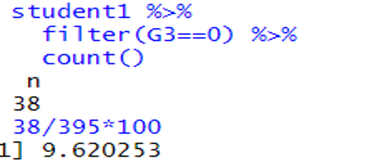
EXPLORATORY DATA ANALYSIS
Both the histogram and the density plot indicate that there are students who got 0. Could this be due to non attendance of exams. Let us find out the number of students who got 0.
38 students in total out of 395 have got a score of 0. That is 9.62% students
Let us check the mean for both groups by removing students who got zeros.
We have created a new data frame called student 2 which includes a total of 357 students with no zero marks

Slide 8
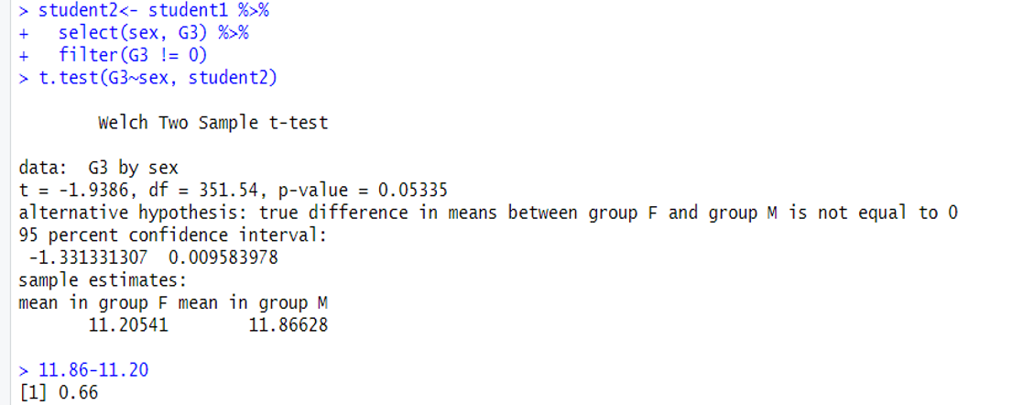
CONCLUSION
Mean of females is 11.20 and 11.86 of males. The difference in mean of the two groups is 0.66 as compared to the earlier mean difference of 0.95
P value is shown as 0.05335. For us to reject the null hypothesis the p value should be less than 0.05
Therefore, it is difficult to say if it is statistically significant

